Slide 1
Chapter 9: Implementing the Cisco Adaptive Security Appliance
CCNA Security v2.0

Slide 2
Chapter Outline
9.0 Introduction
9.1 Introduction to the ASA
9.2 ASA Firewall Configuration
9.3 Summary

Slide 3
Section 9.1: Introduction to the ASA
Upon completion of this section, you should be able to:
Compare ASA solutions to other routing firewall technologies.
Explain ASA 5505 operation with the default configuration.

Slide 4
Topic 9.1.1: ASA Solutions

Slide 5
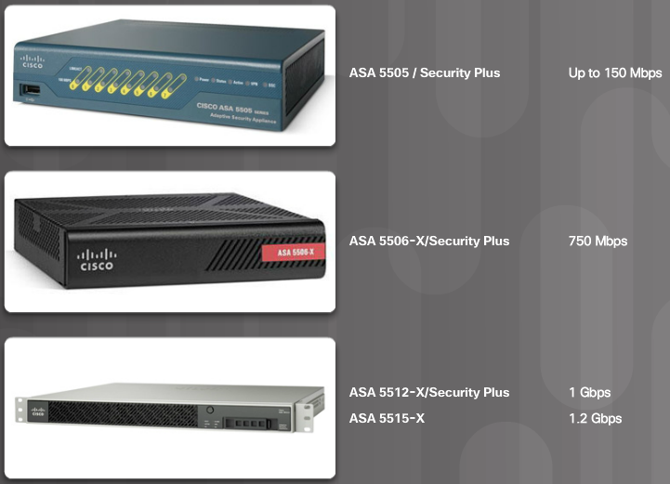
ASA Firewall Models
Small Office and Branch Office ASA Models
Notes:
9.1.1.1 ASA Firewall Models

Slide 6
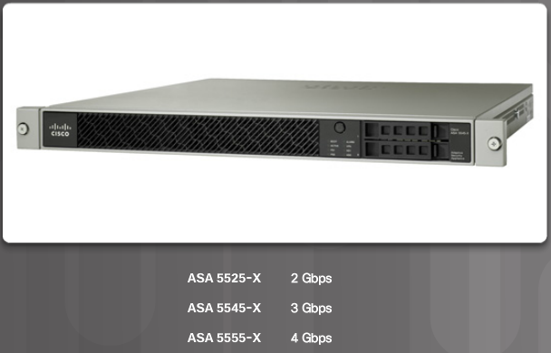
ASA Firewall Models (Cont.)
Internet Edge Models
Notes:
9.1.1.1 ASA Firewall Models (Cont.)

Slide 7
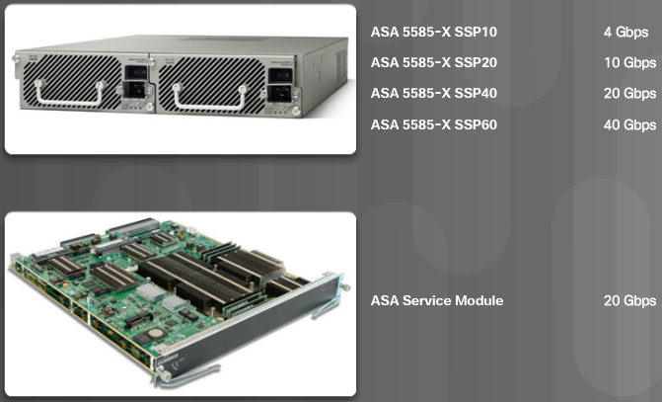
ASA Firewall Models (Cont.)
Enterprise Data Center Models
Notes:
9.1.1.1 ASA Firewall Models (Cont.)
9.1.1.2 Cisco ASA Next-Generation Firewall Appliances: Video - Introducing Cisco ASA with FirePOWER Services

Slide 8
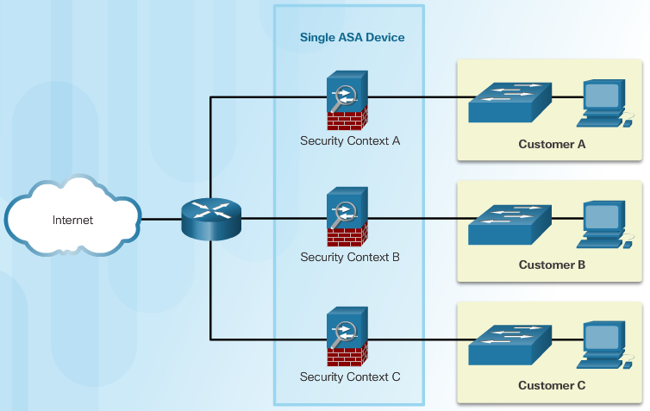
Advanced ASA Firewall Feature
ASA Virtualization
Notes:
9.1.1.3 Advanced ASA Firewall Feature

Slide 9
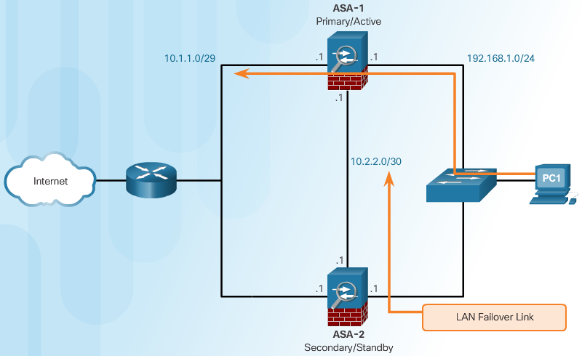
Advanced ASA Firewall Feature (Cont.)
High Availability
Notes:
9.1.1.3 Advanced ASA Firewall Feature (Cont.)

Slide 10
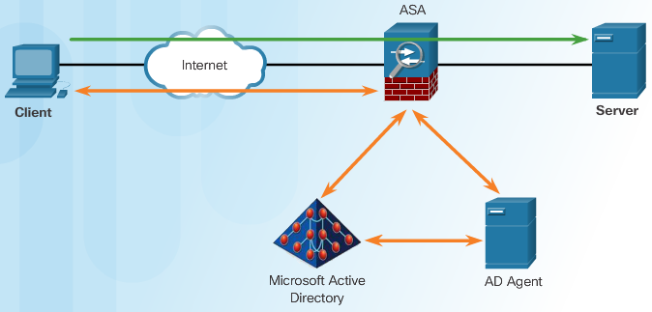
Advanced ASA Firewall Feature (Cont.)
Identity Firewall
Notes:
9.1.1.3 Advanced ASA Firewall Feature (Cont.)

Slide 11
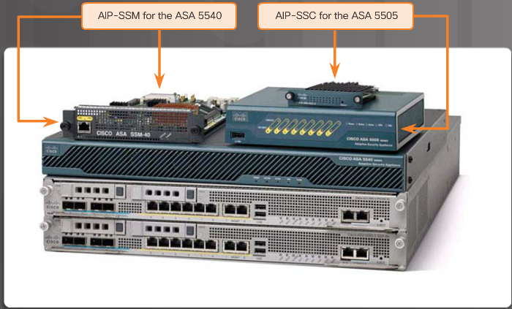
Advanced ASA Firewall Feature (Cont.)
ASA Threat Control
Notes:
9.1.1.3 Advanced ASA Firewall Feature (Cont.)

Slide 12
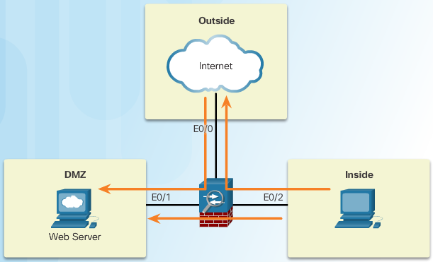
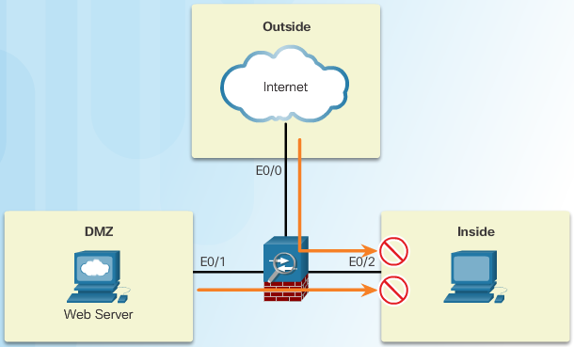
Review of Firewalls in Network Design
Permitted Traffic
DeniedTraffic
Notes:
9.1.1.4 Review of Firewalls in Network Design

Slide 13
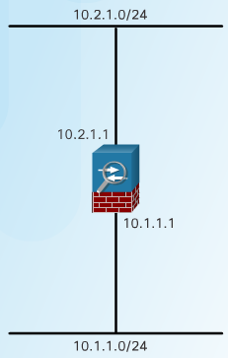
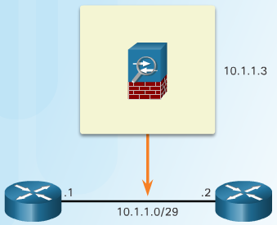
ASA Firewall Modes of Operation
Routed Mode
Transparent Mode
Notes:
9.1.1.5 ASA Firewall Modes of Operation

Slide 14
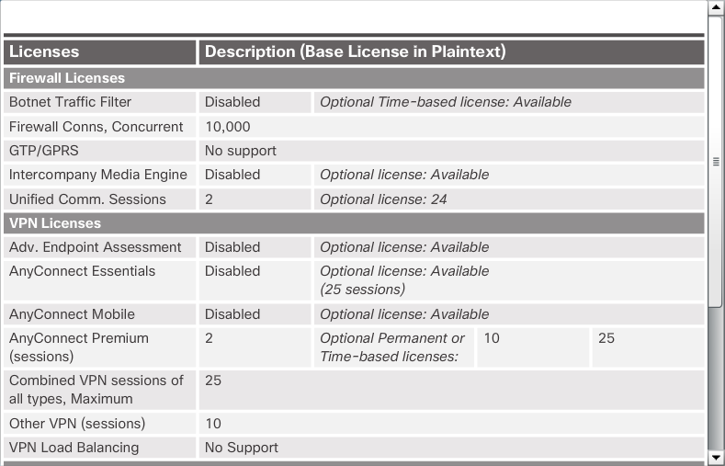
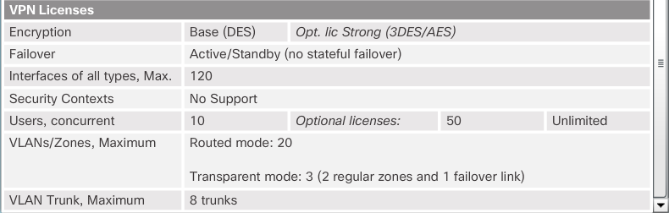
ASA Licensing Requirements
Base License Specifics
Notes:
9.1.1.6 ASA Licensing Requirements

Slide 15
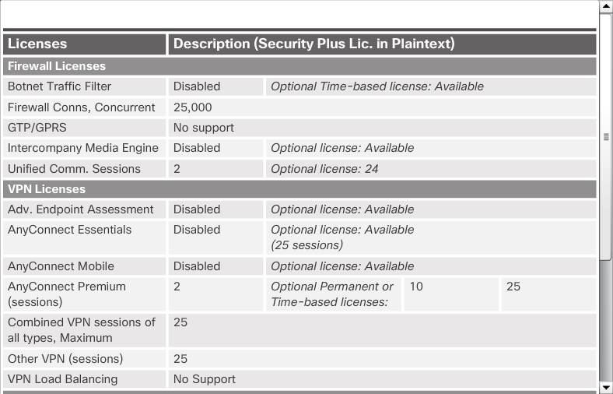

ASA Licensing Requirements (Cont.)
Security Plus License Specifics
Notes:
9.1.1.6 ASA Licensing Requirements (Cont.)

Slide 16
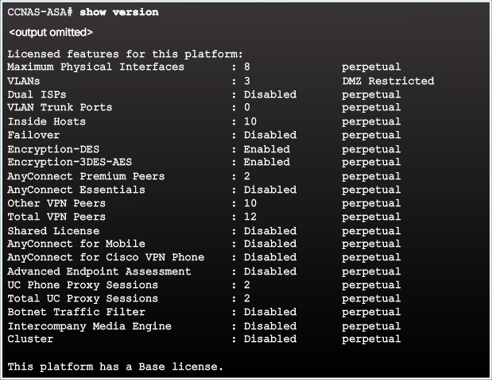
ASA Licensing Requirements
show version Command Output
Notes:
9.1.1.6 ASA Licensing Requirements

Slide 17
Topic 9.1.2: Basic ASA Configuration

Slide 18
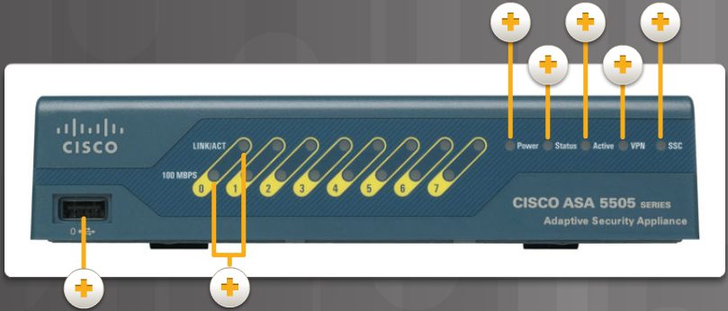
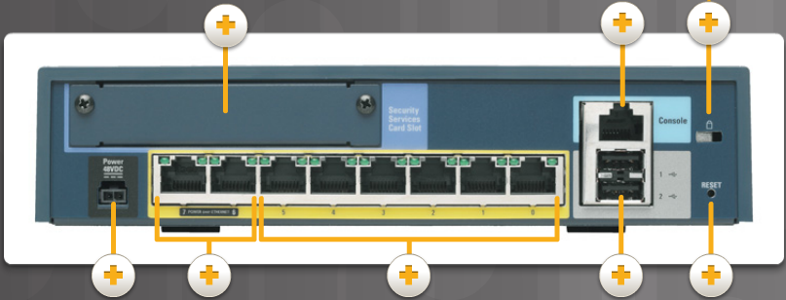
Overview of ASA 5505
ASA 5505 Back Panel
ASA 5505 Front Panel
Notes:
9.1.2.1 Overview of ASA 5505

Slide 19
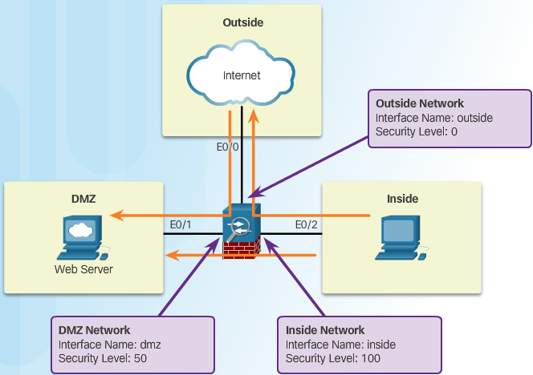
ASA Security Levels
Security Level Control:
Network Access
Inspection Engines
Application Filtering
Notes:
9.1.2.2 ASA Security Levels

Slide 20
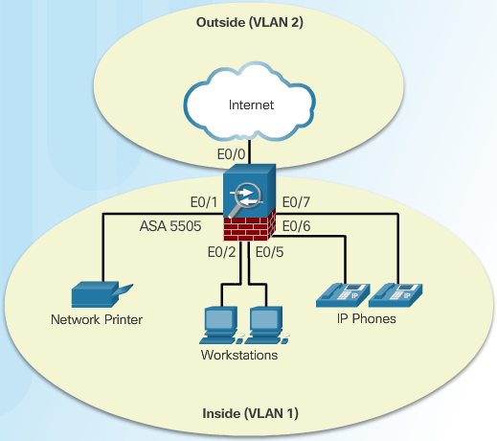
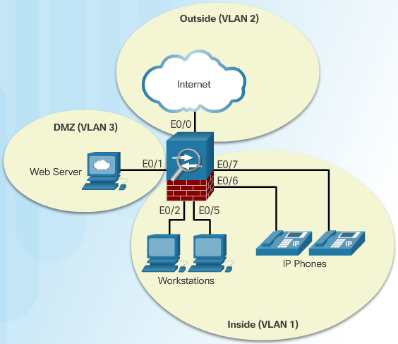
ASA 5505 Deployment Scenarios
ASA Deployment in a Small Branch
ASA Deployment in a Small Business
Notes:
9.1.2.3 ASA 5505 Deployment Scenarios

Slide 21
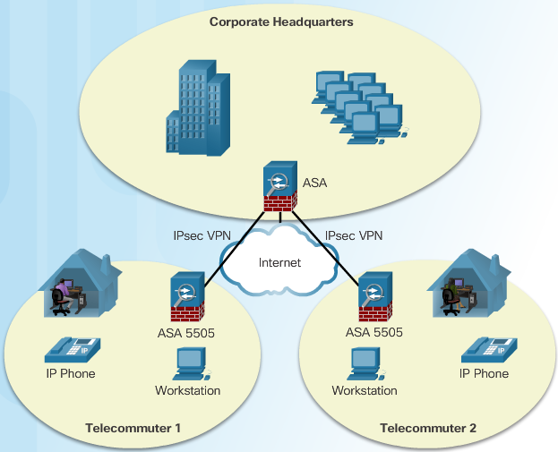
ASA 5505 Deployment Scenarios (Cont.)
ASA Deployment in an Enterprise
Notes:
9.1.2.3 ASA 5505 Deployment Scenarios (Cont.)

Slide 22
Section 9.2: ASA Firewall Configuration
Upon completion of this section, you should be able to:
Explain what ASA firewall services are enabled using the default configuration.
Configure an ASA to provide basic firewall services.
Configure object groups on an ASA.
Configure access lists with object groups on an ASA.
Configure an ASA to provide NAT services.
Configure access control using the local database and AAA server.
Explain how the Cisco Modular Framework (MPF) is used to configure ASA policies.

Slide 23
Topic 9.2.1: The ASA Firewall Configuration

Slide 24
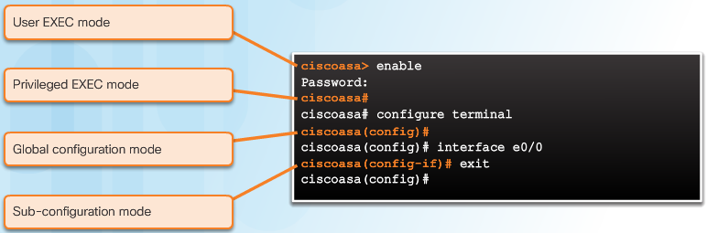
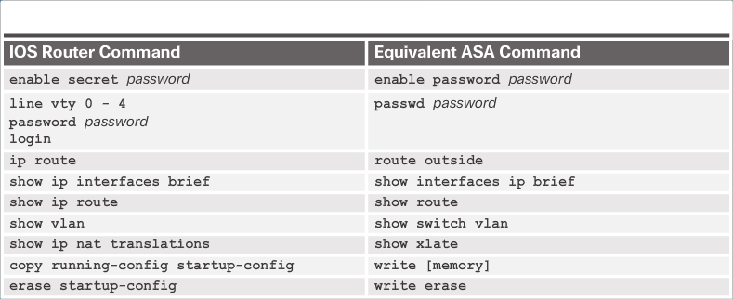
Introduce Basic ASA Settings
Base License Specifics
Security Plus License Specifics
Notes:
9.2.1.1 Introduce Basic ASA Settings

Slide 25
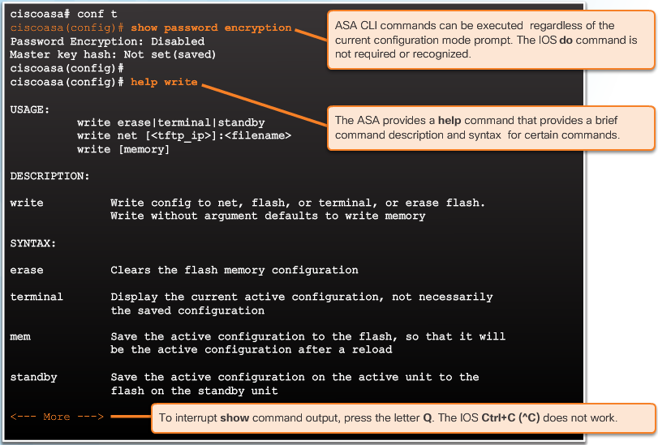
Introduce Basic ASA Settings (Cont.)
show version Command Output
Notes:
9.2.1.1 Introduce Basic ASA Settings (Cont.)

Slide 26
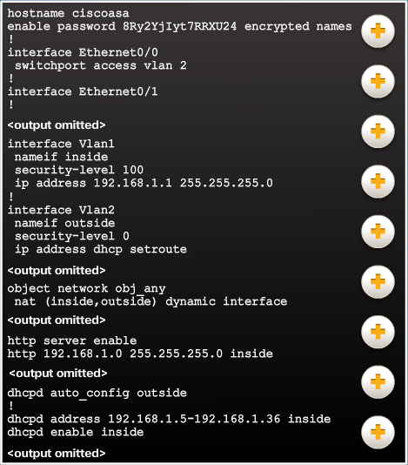
ASA Default Configuration
ASA 5505 Default Configuration Overview.
Notes:
9.2.1.2 ASA Default Configuration

Slide 27
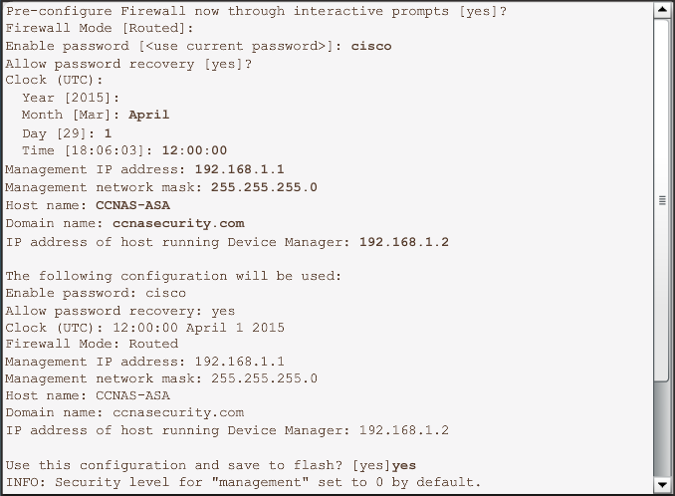
ASA Interactive Setup Initialization Wizard
Entering the ASA 5505 Setup Initialization Wizard
Notes:
9.2.1.3 ASA Interactive Setup Initialization Wizard

Slide 28
Topic 9.2.2: Configuring Management Settings and Services

Slide 29
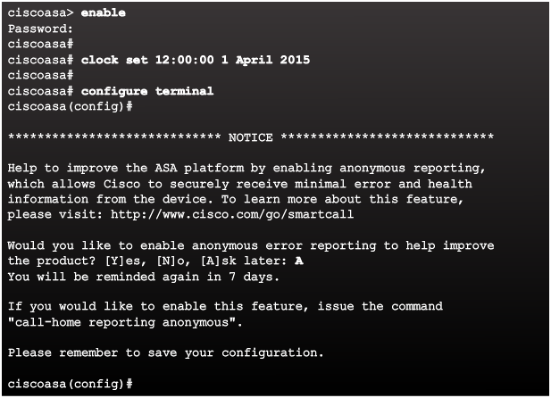
Enter Global Configuration Mode
Entering Global Configuration Mode Example
Notes:
9.2.2.1 Enter Global Configuration Mode

Slide 30
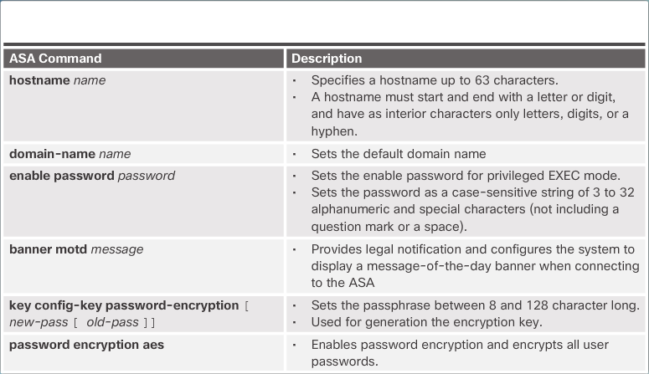
Configuring Basic Settings
ASA Basic Configuration Commands
Notes:
9.2.2.2 Configuring Basic Settings

Slide 31
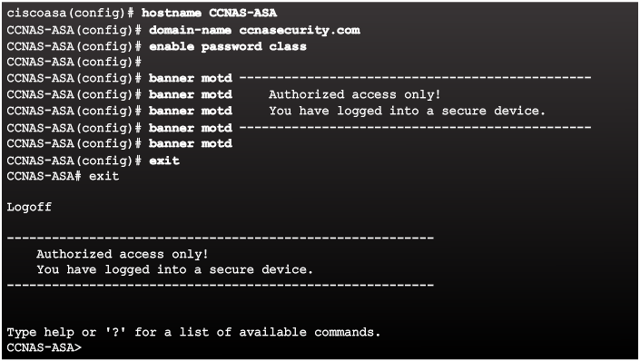
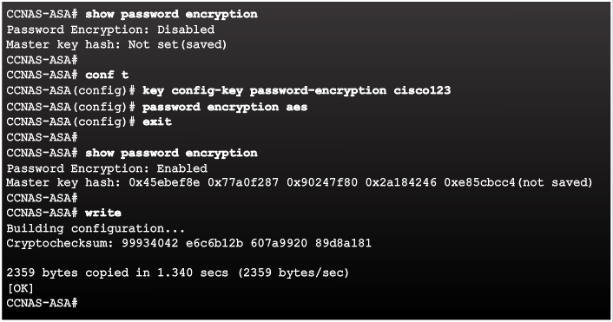
Configuring Basic Settings (Cont.)
Configuring Basic Settings
Enabling AES Encryption Example
Notes:
9.2.2.2 Configuring Basic Settings (Cont.)

Slide 32
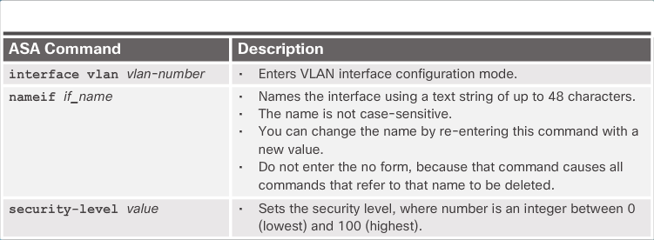
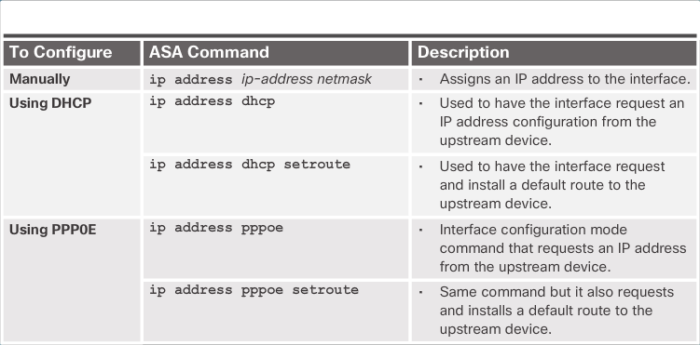
Configuring Logical VLAN Interfaces
Local VLAN Interface Commands
Configuring IP Addresses on VLAN Interfaces
Notes:
9.2.2.3 Configuring Logical VLAN Interfaces

Slide 33
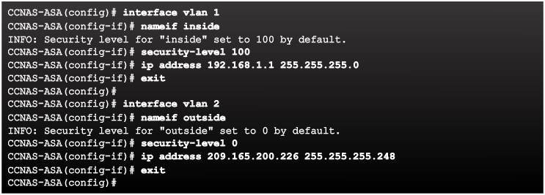
Configuring Logical VLAN Interfaces (Cont.)
Configuring VLAN Interfaces Example
Notes:
9.2.2.3 Configuring Logical VLAN Interfaces (Cont.)

Slide 34
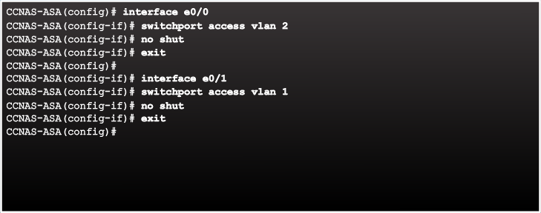
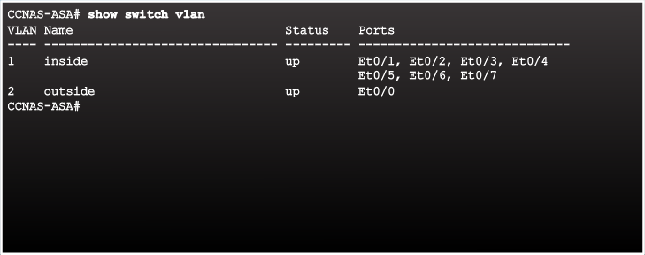
Assigning Layer 2 Ports to VLANs
Configuring Layer 2 Ports Example
Verifying VLAN Port Assignment Example
Notes:
9.2.2.4 Assigning Layer 2 Ports to VLANs

Slide 35
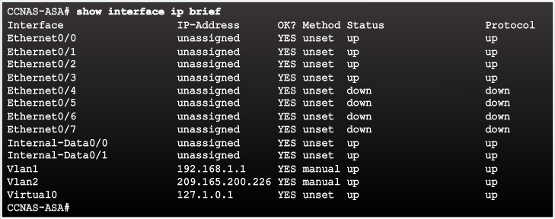
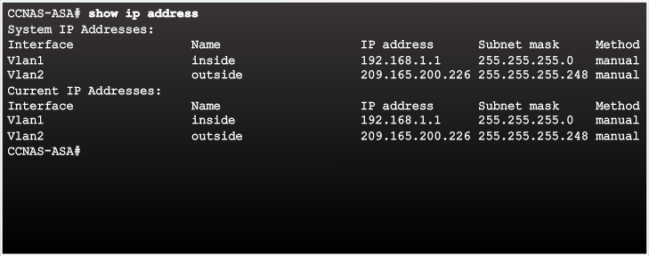
Assigning Layer 2 Ports to VLANs (Cont.)
Verifying Interfaces Example
Verifying IP Addresses Example
Notes:
9.2.2.4 Assigning Layer 2 Ports to VLANs (Cont.)

Slide 36
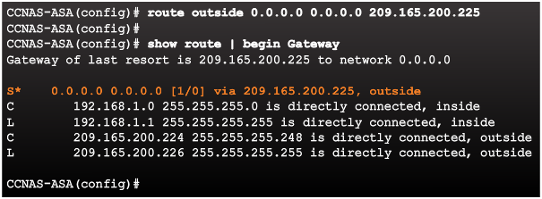
Configuring a Default Static Route
Notes:
9.2.2.5 Configuring a Default Static Route

Slide 37
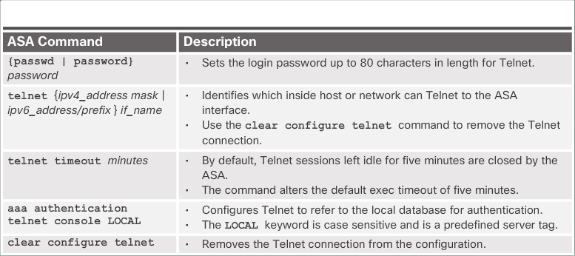
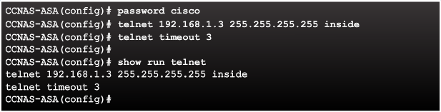
Configuring Remote Access Services
Telnet Configuration Commands
Telnet Configuration Commands Example
Notes:
9.2.2.6 Configuring Remote Access Services

Slide 38
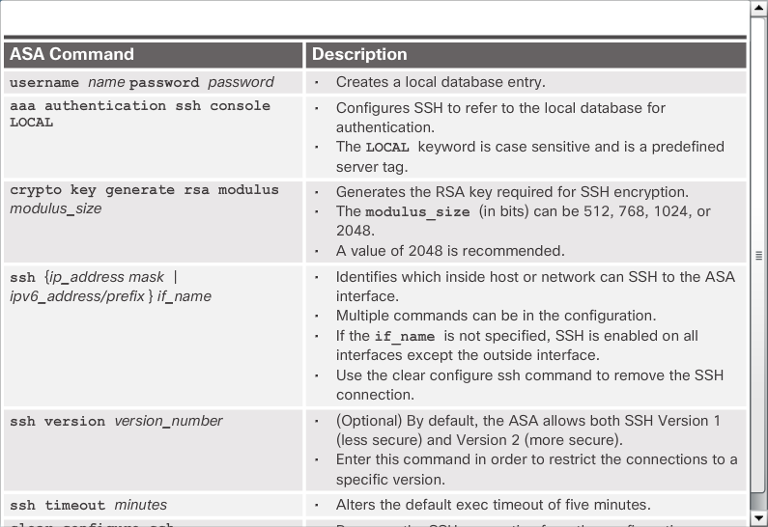
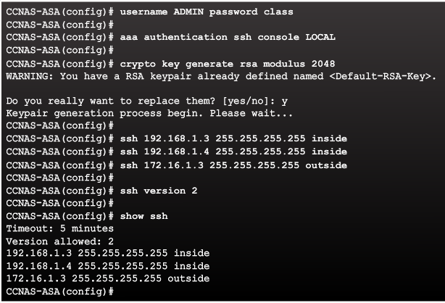
Configuring Remote Access Services (Cont.)
SSH Configuration Commands
Configuring SSH Access Example
Notes:
9.2.2.6 Configuring Remote Access Services (Cont.)

Slide 39
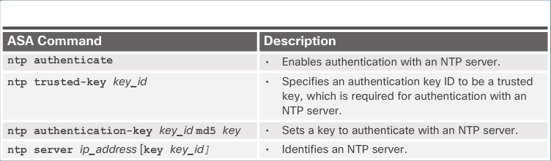
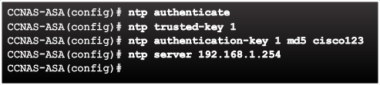
Configuring Network Time Protocol Services
NTP Authentication Commands
Configuring NTP Example
Notes:
9.2.2.7 Configuring Network Time Protocol Services

Slide 40
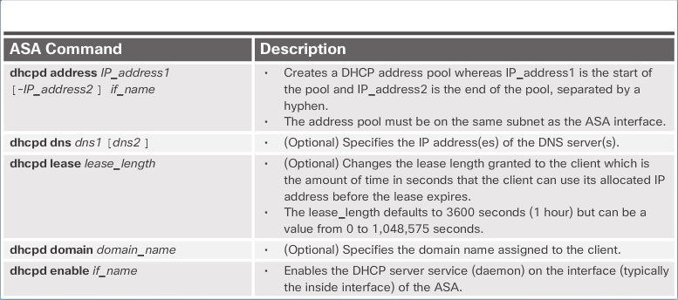
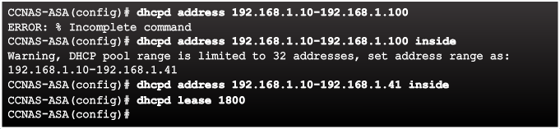
Configuring DHCP Services
DHCP Server Commands
Configuring DHCP Server Example
Notes:
9.2.2.8 Configuring DHCP Services

Slide 41
Topic 9.2.3: Object Groups

Slide 42
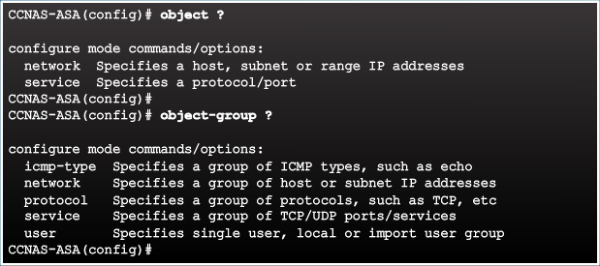
Introduction to Objects and Object Groups
Notes:
9.2.3.1 Introduction to Objects and Object Groups

Slide 43
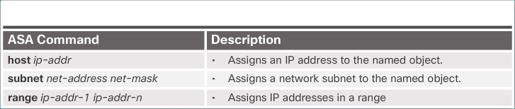
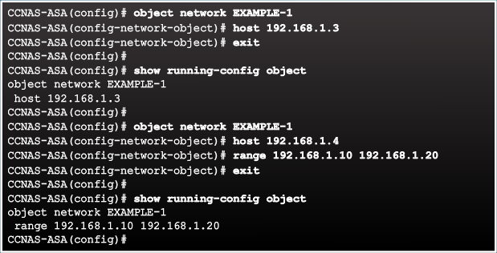
Configuring Network Objects
Network Object Commands
Configuring a Network Object Example
Notes:
9.2.3.2 Configuring Network Objects

Slide 44
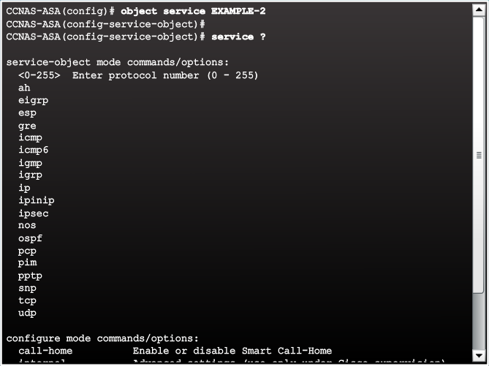
Configuring Service Objects
Service Object Options Example
Notes:
9.2.3.3 Configuring Service Objects

Slide 45


Configuring Service Objects (Cont.)
Common Service Object Commands
Configuring a Service Object Example
Notes:
9.2.3.3 Configuring Service Objects (Cont.)

Slide 46

Object Groups
Notes:
9.2.3.4 Object Groups

Slide 47


Configuring Common Object Groups
Network Object Group Example
ICMP-type Object Group Example
Notes:
9.2.3.5 Configuring Common Object Groups

Slide 48

Configuring Common Object Groups (Cont.)
Services Object Group Example
Notes:
9.2.3.5 Configuring Common Object Groups (Cont.)
9.2.3.6 Activity – Identify Types of Object Groups

Slide 49
Configuring Common Object Groups (Cont.)
Services Object Group Example
Notes:
9.2.3.5 Configuring Common Object Groups (Cont.)
9.2.3.6 Activity – Identify Types of Object Groups

Slide 50
Topic 9.2.4: ACLS

Slide 51


ASA ACLs
ASA ACL and IOS ACL Similarities
ASA ACL and IOS ACL Similarities
Notes:
9.2.4.1 ASA ACLs

Slide 52


Types of ASA ACL Filtering
Higher Levels Allowed To Lower Levels
Lower Levels Denied To Higher Levels
Notes:
9.2.4.2 Types of ASA ACL Filtering

Slide 53



Types of ASA ACLs
Extended ACL Examples
Standard ACL Example
IPv6 ACL Example
Notes:
9.2.4.3 Types of ASA ACLs

Slide 54

Configuring ACLs
ACL Command Parameters
Notes:
9.2.4.4 Configuring ACLs

Slide 55

Configuring ACLs (Cont.)
Condensed Extended ACL Syntax
Notes:
9.2.4.4 Configuring ACLs (Cont.)

Slide 56


Configuring ACLs (Cont.)
ASA ACL Elements
Notes:
9.2.4.4 Configuring ACLs (Cont.)

Slide 57

Applying ACLs
access-group Command Syntax
Notes:
9.2.4.5 Applying ACLs

Slide 58

ACLs and Object Groups
ACL Reference Topology
Notes:
9.2.4.6 ACLs and Object Groups

Slide 59


ACLs and Object Groups (Cont.)
Extended ACL Configuration Example
Verifying the ACL
Notes:
9.2.4.6 ACLs and Object Groups (Cont.)

Slide 60


ACL Using Object Groups Examples
Condensed Extended ACL Syntax with Object Groups
ACL Reference Topology
Notes:
9.2.4.7 ACL Using Object Groups Examples

Slide 61


ACL Using Object Groups Examples
ACL and Object Group Configuration Example
Verifying the ACL and Object Group Configuration Example
Notes:
9.2.4.7 ACL Using Object Groups Examples

Slide 62
Topic 9.2.5: NAT Services on an ASA

Slide 63

ASA NAT Overview
Types of NAT Deployments:
Inside NAT
Outside NAT
Bidirectional NAT
Notes:
9.2.5.1 ASA NAT Overview

Slide 64

Configuring Dynamic NAT
Dynamic NAT Reference Topology
Notes:
9.2.5.2 Configuring Dynamic NAT

Slide 65



Configuring Dynamic NAT (Cont.)
Dynamic NAT Configuration Example
Enable Return Traffic Example
Verifying the Dynamic NAT Configuration Example
Notes:
9.2.5.2 Configuring Dynamic NAT (Cont.)

Slide 66


Configuring Dynamic PAT
Dynamic PAT Configuration Example
Verifying the Dynamic PAT Configuration Example
Notes:
9.2.5.3 Configuring Dynamic PAT

Slide 67


Configuring Static NAT
Configure the DMZ Interface Example
Static NAT Configuration Example
Notes:
9.2.5.4 Configuring Static NAT

Slide 68

Configuring Static NAT (Cont.)
Verifying the Static NAT Configuration Example
Notes:
9.2.5.4 Configuring Static NAT (Cont.)

Slide 69
Topic 9.2.6: AAA

Slide 70

AAA Review
Notes:
9.2.6.1 AAA Review

Slide 71


Local Database and Servers
RADIUS and TACACS+ Server Commands
Sample AAA TACACS+ Server Configuration
Notes:
9.2.6.2 Local Database and Servers

Slide 72

AAA Configuration
Notes:
9.2.6.3 AAA Configuration

Slide 73
Topic 9.2.7: Service Policies on an ASA

Slide 74

Overview of MPF
Notes:
9.2.7.1 Overview of MBF

Slide 75

Configuring Class Maps
Notes:
9.2.7.2 Configuring Class Maps

Slide 76

Define and Activate a Policy
Implementing Modular Policy Framework
Notes:
9.2.7.3 Define and Activate a Policy

Slide 77

ASA Default Policy
Default Service Policy Configuration
Notes:
9.2.7.4 ASA Default Policy

Slide 78
Section 9.3: Summary
Chapter Objectives:
Explain how the ASA operates as an advanced stateful firewall.
Implement an ASA firewall configuration.
Notes:
9.3.1.1 Packet Tracer – Configure ASA Basic Settings and Firewall Using CLI
9.3.1.2 Lab – Configure ASA Basic Settings and Firewall Using CLI
9.3.1.3 Chapter 9: Implementing the Cisco Adaptive Security Appliance

Slide 80


Instructor Resources
Remember, there are helpful tutorials and user guides available via your NetSpace home page. (https://www.netacad.com)
These resources cover a variety of topics including navigation, assessments, and assignments.
A screenshot has been provided here highlighting the tutorials related to activating exams, managing assessments, and creating quizzes.
1
2
Notes:
https://www.netacad.com

